Slide 1

DML Commands

Slide 2
Data Manipulation Language
DML is used for inserting, deleting, and updating data in a database. It is used to retrieve and manipulate data in a relational database. It includes INSERT, UPDATE, and DELETE. Let's discuss these commands one at a time.

Slide 3
Data Manipulation Language
Language for accessing and manipulating the data organized by the appropriate data model
  DML also known as query language
Two classes of languages
Pure – used for proving properties about computational power and for optimization
  Relational Algebra
  Tuple relational calculus
  Domain relational calculus
Commercial – used in commercial systems
SQL is the most widely used commercial language

Slide 4
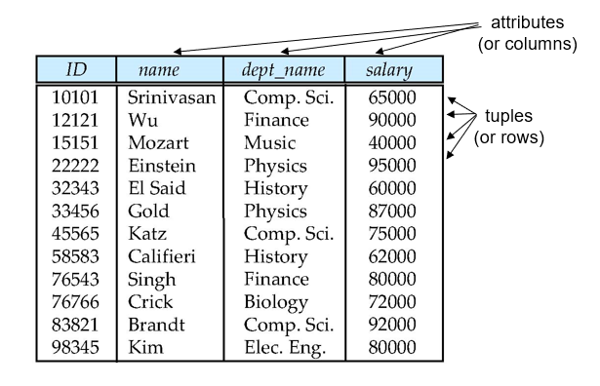
Data Manipulation Language

Slide 5
Attribute Types
The set of allowed values for each attribute is called the domain of the attribute
Attribute values are (normally) required to be atomic; that is, indivisible
The special value null is a member of every domain. Indicated that the value is “unknown”
The null value causes complications in the definition of many operations

Slide 6
Data Manipulation Language
A DML statement is executed when you:
Add new rows to a table
Modify existing rows in a table
Remove existing rows from a table
A transaction consists of a collection of DML statements that form a logical unit of work.

Slide 7
INSERT
Insert statement is used to insert data in a SQL table. Using the Insert query, we can add one or more rows to the table. Following is the syntax of the MySQL INSERT Statement.
INSERT INTO table_name
(attribute1, attribute2, ...)
VALUES(val1, val2, ...)
Example:
insert into my_table
values("myName3", 5, false),
("myName4", 51, true);

Slide 8
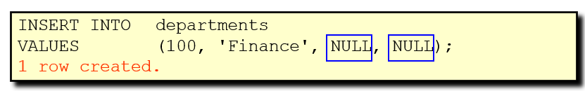
INSERT
INSERT INTO departments (department_id, department_name, manager_id, location_id) VALUES (70, 'Public Relations', 100, 1700);
1 row created.
Inserting Rows with Null Values:

Slide 9
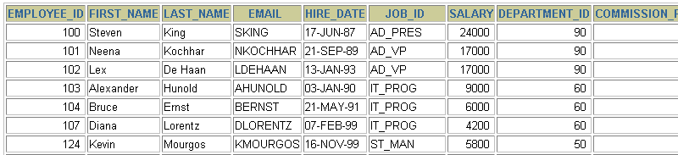
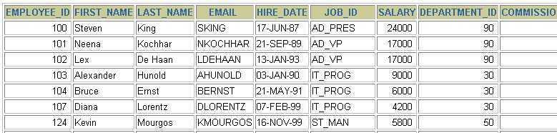
Changing Data in a Table
EMPLOYEES

Slide 10
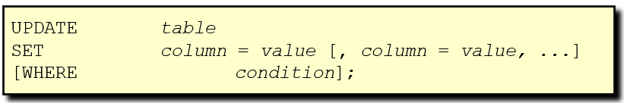
The UPDATE Statement Syntax
Modify existing rows with the UPDATE statement.
Update more than one row at a time, if required.

Slide 11
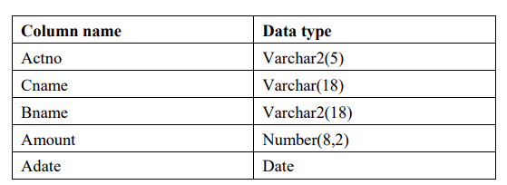
Example:1
Create a table deposit with the following specifications.

Slide 12
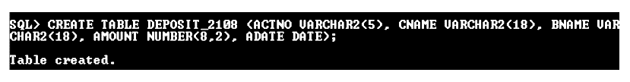
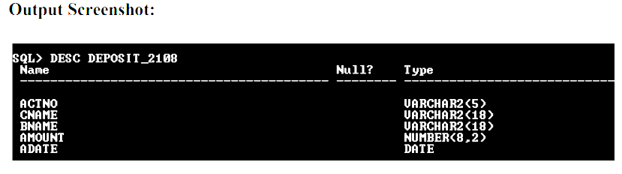
Example:1
Query:

Slide 13
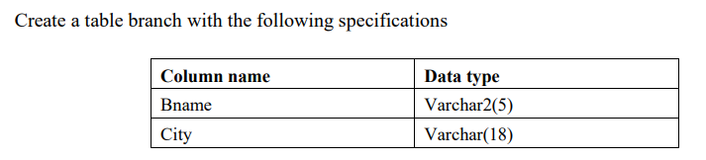

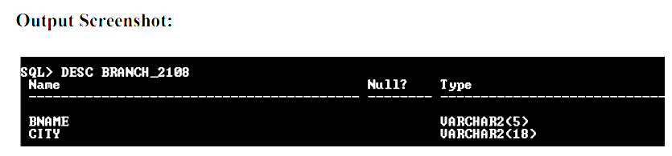
Example:1

Slide 14
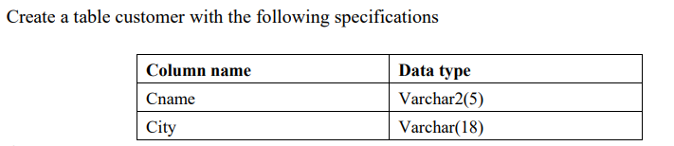
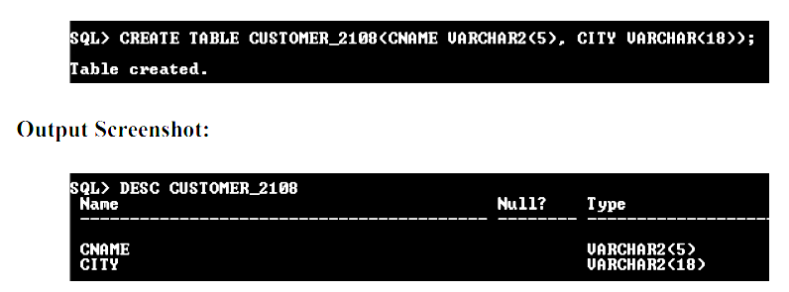
Example:1

Slide 15
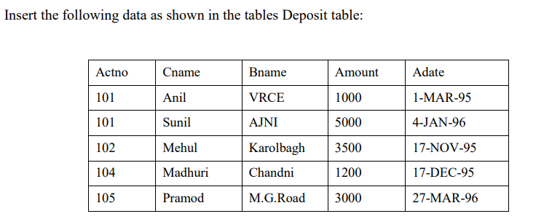
Example:1

Slide 16
Example:1

Slide 17
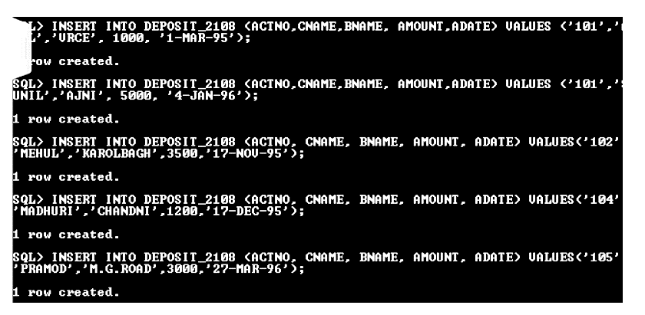
Example:1

Slide 18
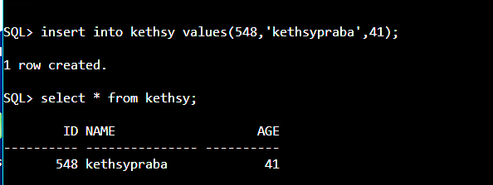
Example:1

Slide 19
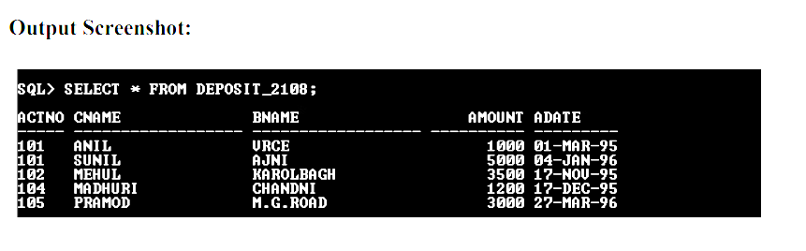
Example:1

Slide 20
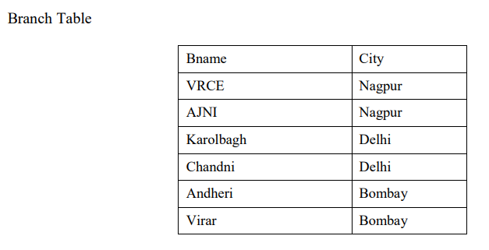
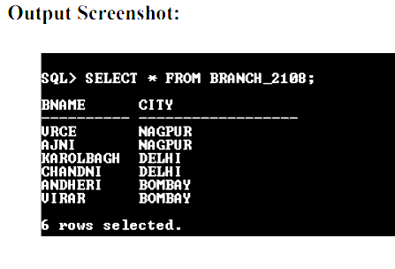
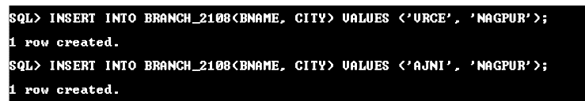
Example:1

Slide 21
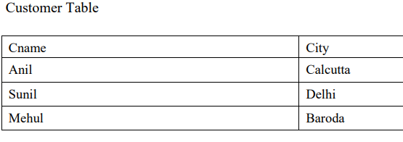
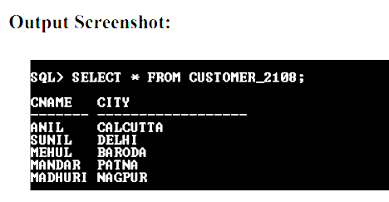
Example:1

Slide 22
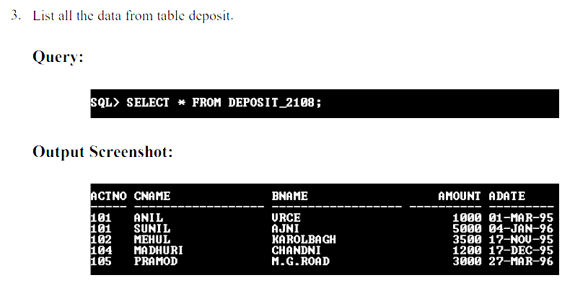
Example:1

Slide 23
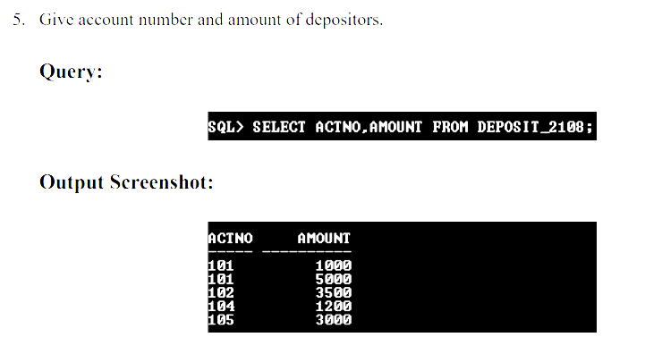
Example:1

Slide 24
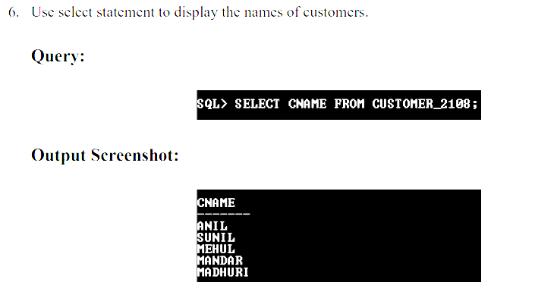
Example:1

Slide 25
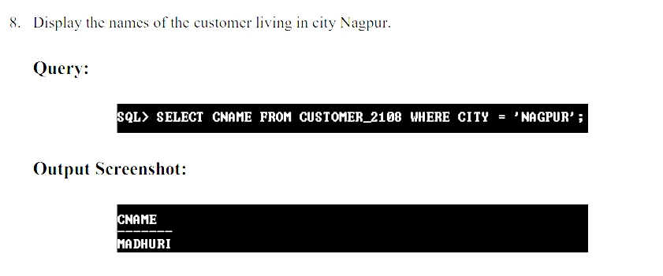
Example:1

Slide 26
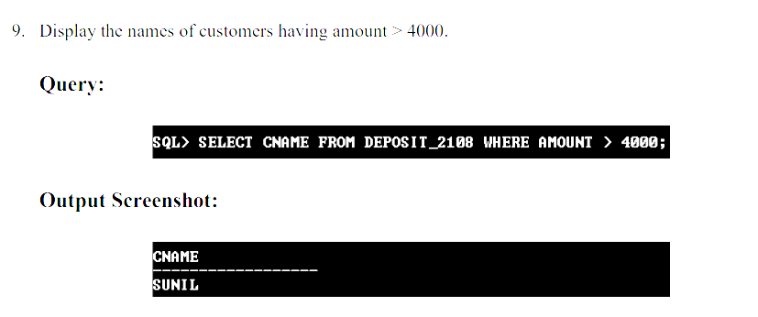
Example:1

Slide 27
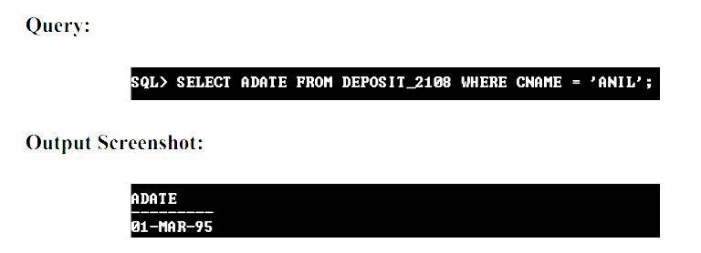
Example:1
Display the account date of customer Anil

Slide 28
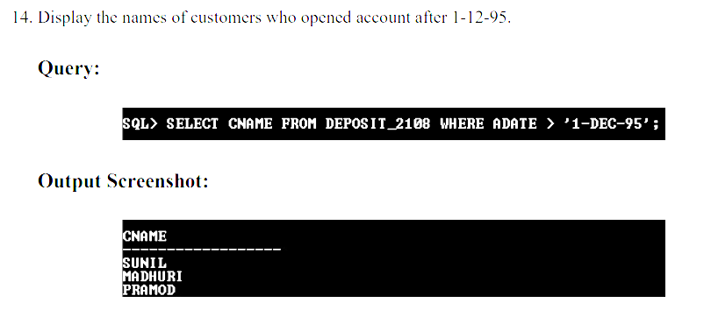
Example:1

Slide 29
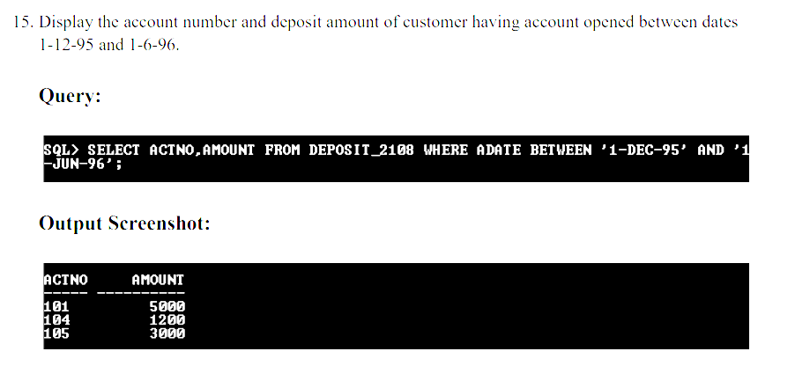
Example:1

Slide 30
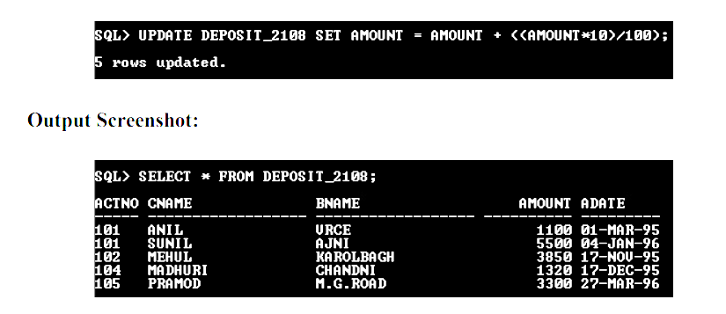
Example:1
Give 10% interest to all depositors.

Slide 31
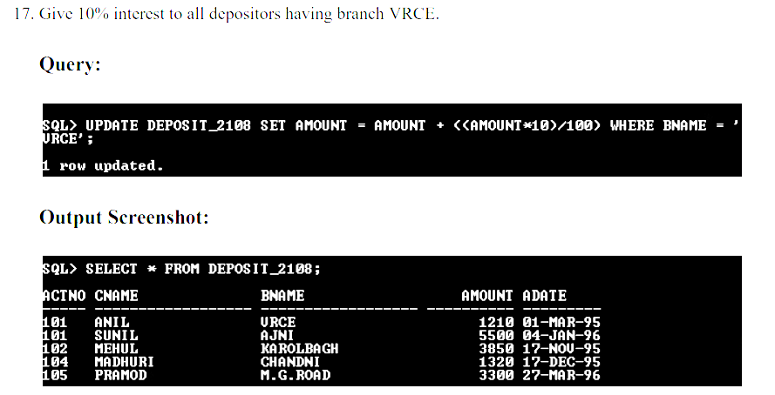
Example:1

Slide 32
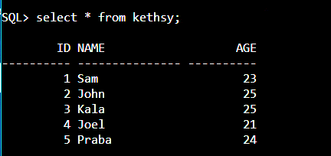
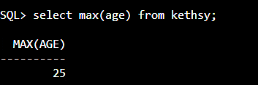
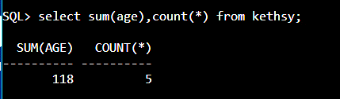
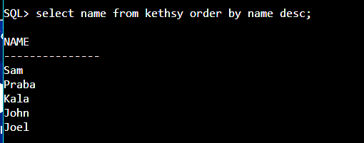
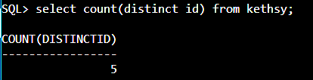
Example:1

Slide 33
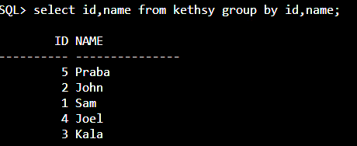
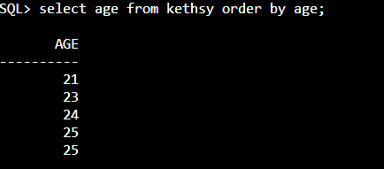
Example:1

